Slide 1
ISB Vietnam Corporation
Machine Learning Basics For A Newbie
Presenter: Hang Dang
HCMC, 2019/05

Slide 2
Contents
“Trending” Terms
TT
Groups of Algorithms
G-As
Artificial Neural Network
ANN
Demo - Mobilenet
MN
2

Slide 3
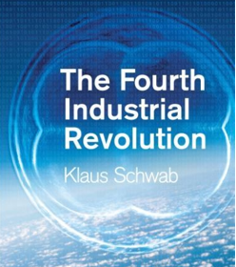

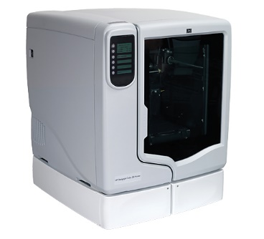

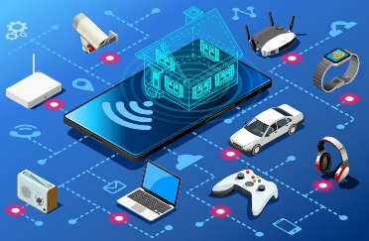




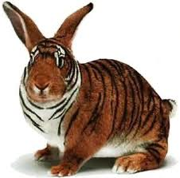
Trending Terms
The Fourth Industrial Revolution
2017
3D Printing Technology
Digital
Physical
IoT
Biotechnology
Gene therapy
Genetically modified Organisms
3

Slide 4


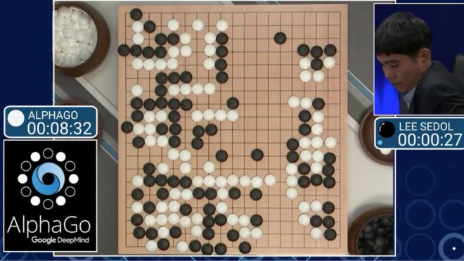
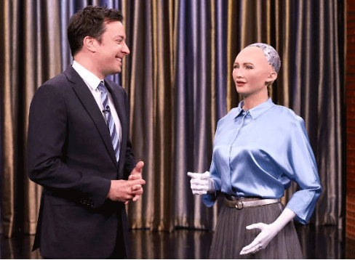

Trending Terms
Artificial Intelligence - AI
A research branch in Computer Science.
By John McCarthy in 1956 at the Dartmouth Conference.
Robot Sophia
4

Slide 5

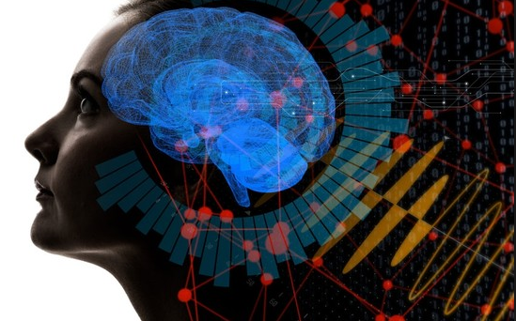
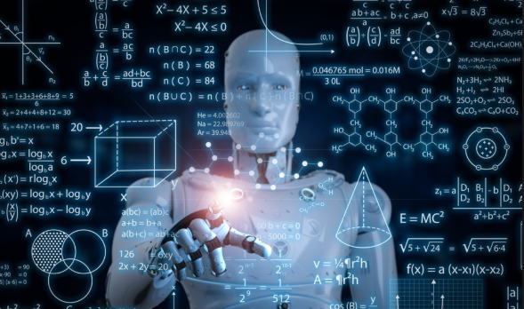

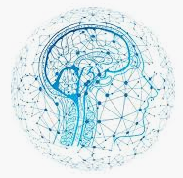
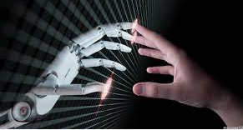
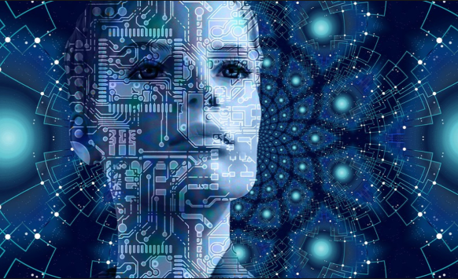
Trending Terms
Artificial Intelligence - AI
Haugeland
Chaniaka & McDemott
Rich and Knight
Nilsson
Winston
→ AI is the intelligence represented by any artificial system. The system will simulate the intellectual activity processes of human, including the process of learning, reasoning and error correction.
→ AI relates to the behavior, learning and smart adaptability of machines in general and computers in particular.
5

Slide 6
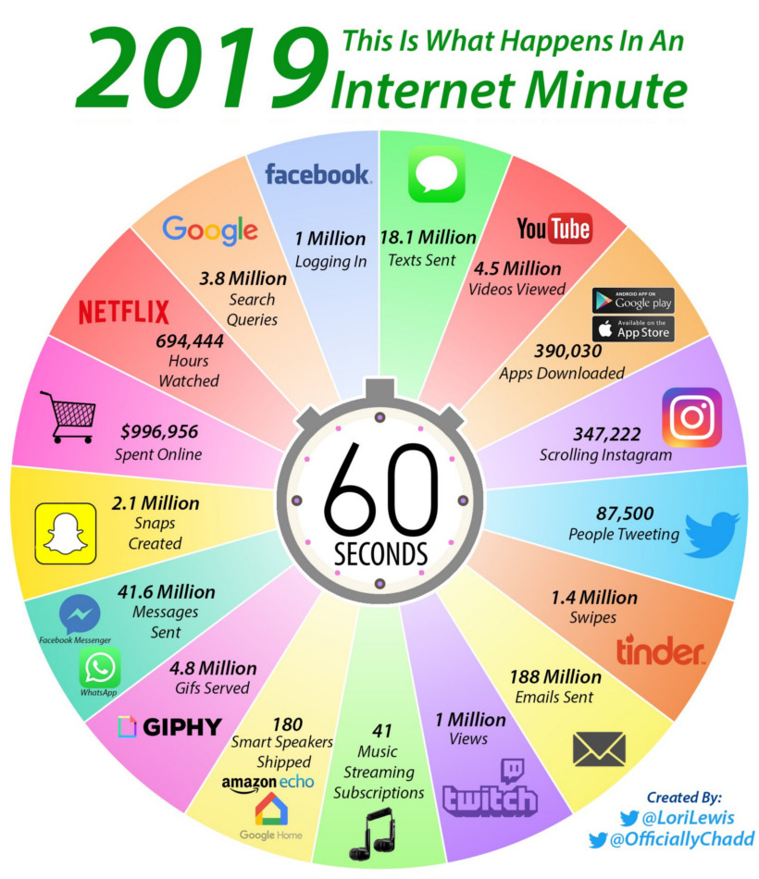

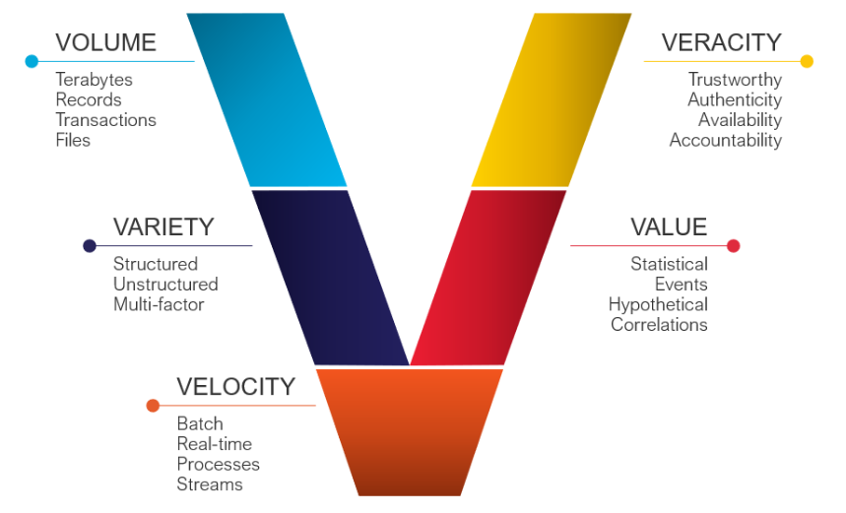
Trending Terms
Big Data
6

Slide 7
Trending Terms
Machine Learning - ML
Is the subfield of computer science that relate to research and building techniques which allow systems automated “learning” (the ability to learn without being explicitly programmed) to solve specifically problems - Arthur Samuel.
A computer program is said to learn from experience E with respect to some task T and some performance measure P, if its performance on T, as measured by P, improves with experience E – Prof. Tom Mitchell (CMU).
Ex, filter the spam email:
+ T: flag spam for new emails.
+ E: is the training data which were flagged spam.
+ P: the ratio of correctly classified emails (accuracy).
Relationship: Machine Learning base on Big data to get target of AI
7

Slide 8
Contents
“Trending” Terms
TT
Groups of Algorithms
G-As
Artificial Neural Network
ANN
Demo - Mobilenet
MN
8

Slide 9

Group of Algorithms
Learning Style
Reinforcement Learning
?
?
?
Supervised Learning
Unsupervised Learning
Semi-supervised Learning
9

Slide 10
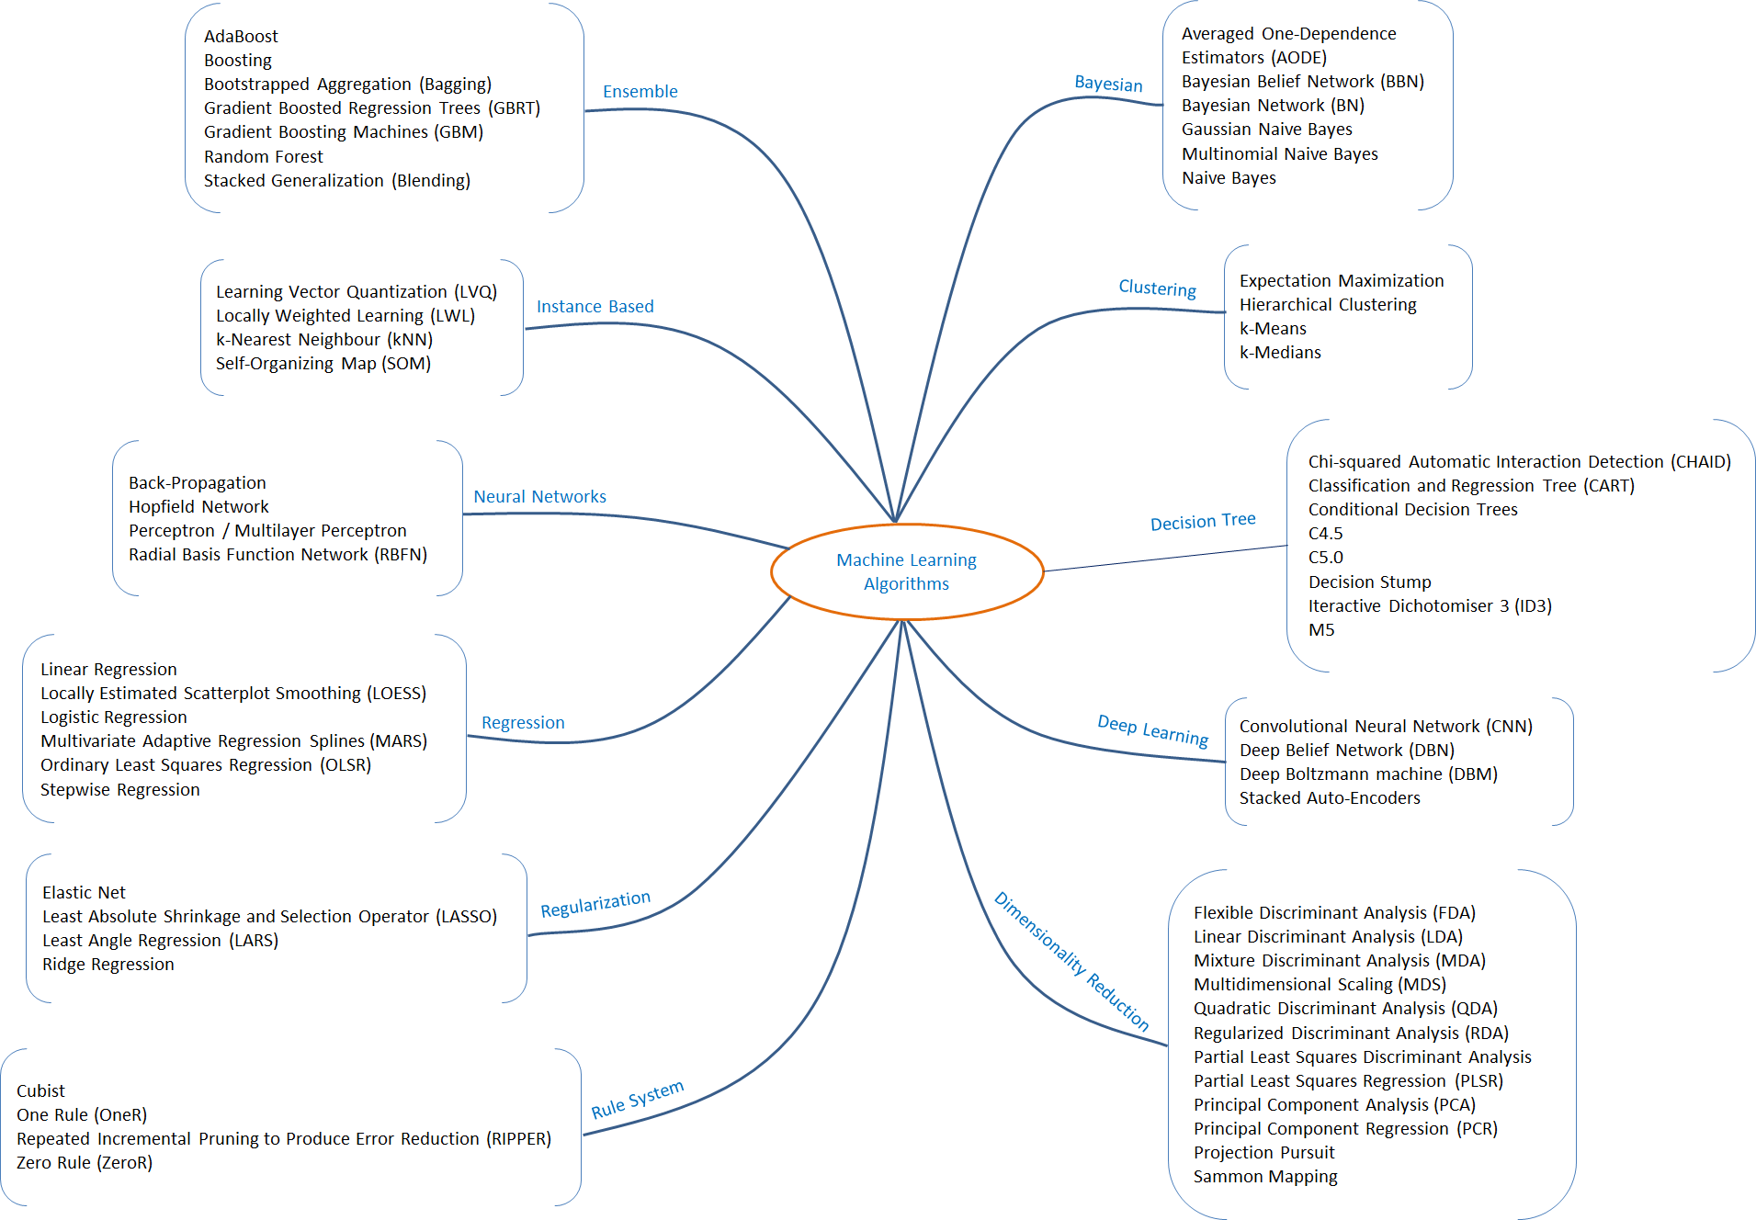
Group of Algorithms
Similarity in form or function
10
https://www.phamduytung.com/blog/2019-04-19-deep-learning-view/

Slide 11
Contents
“Trending” Terms
TT
Groups of Algorithms
G-As
Artificial Neural Network
ANN
Demo - Mobilenet
MN
11

Slide 12
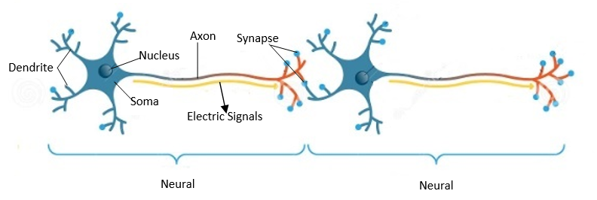
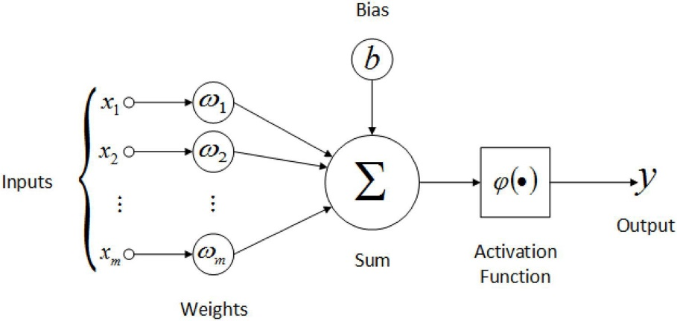
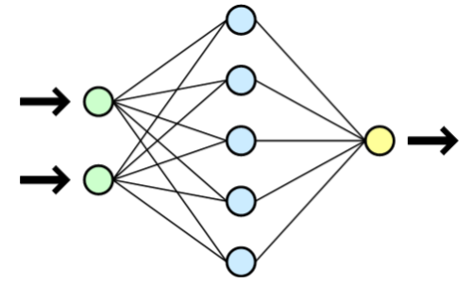
Artificial Neural Network - ANN
Perceptron
Dendrite
Axon
ANN
synapse
Soma
Electric signals
12
Some activation functions at slide 63

Slide 13
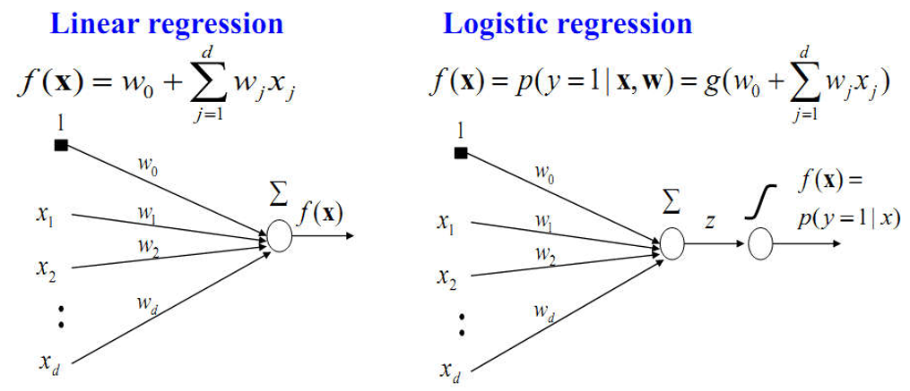
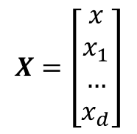
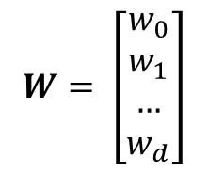
Artificial Neural Network - ANN
Perceptron
$$X=\left[\begin{matrix}x \\ x_{1} \\ … \\ x_{d}\end{matrix}\right]$$
$$W= \left[\begin{matrix}w_{0} \\ w_{1} \\ … \\ w_{d}\end{matrix}\right]$$
13

Slide 14
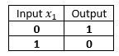
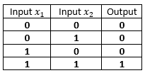
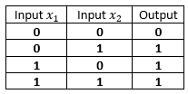
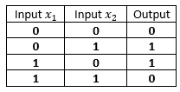
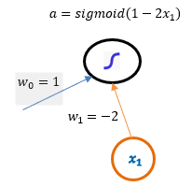
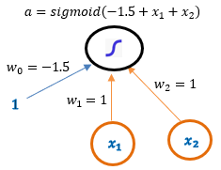
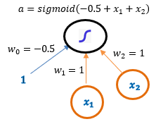
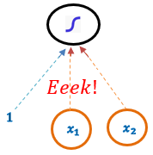
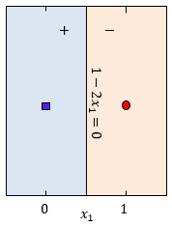
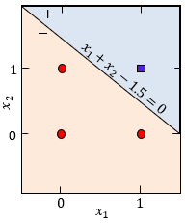
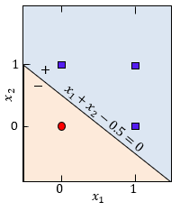
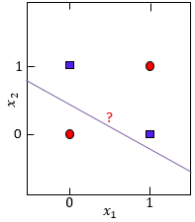
Artificial Neural Network - ANN
Perceptron
Inverter
AND
OR
XOR
14
View more at Slide 64 when activation function is Sign

Slide 15
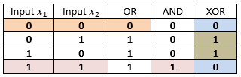
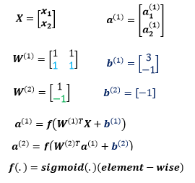
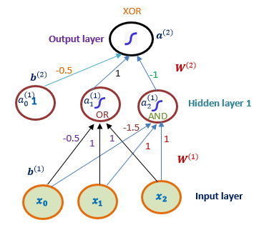
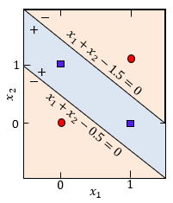
Artificial Neural Network - ANN
Perceptron
15
View more at Slide 65 when activation function is Sign

Slide 16
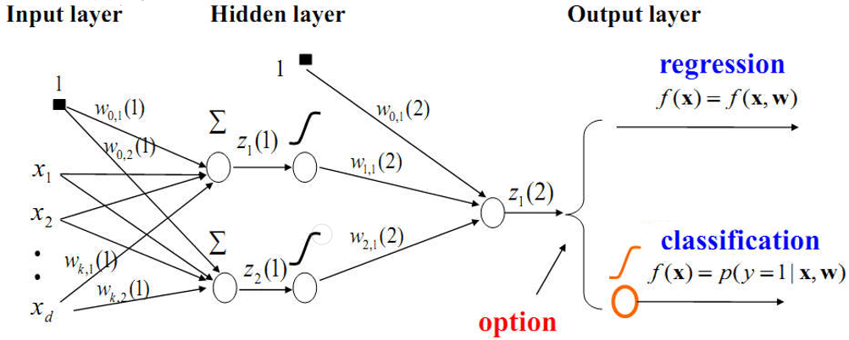
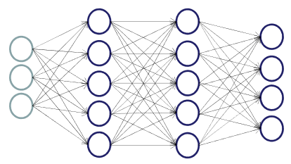



Artificial Neural Network - ANN
Multi-layers Perceptron - MLP
Hidden layer 1
Hidden layer 2
$$W^{(2)}$$
$$W^{(3)}$$
$$W^{\left(1\right)}$$
#layers = #hidden layers + 1, except input layer
Input layer
Output layer
16

Slide 17
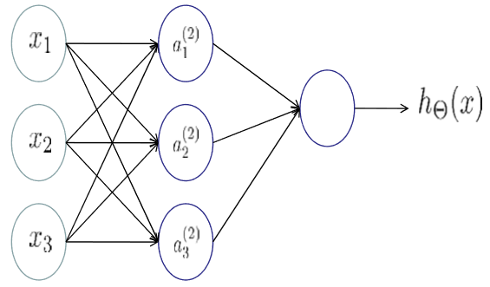
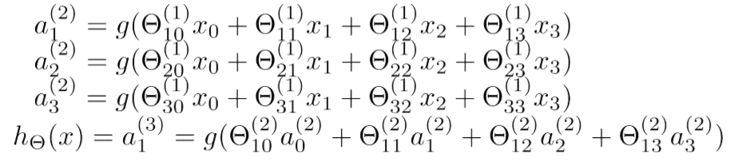
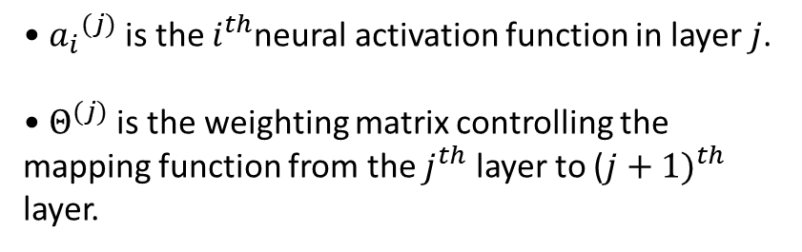
Artificial Neural Network - ANN
Multi-layers Perceptron - MLP
• ${a_{i}}^{(j)}$ is the $i^{th}$neural activation function in layer $j$.
• $Θ^{(j)}$is the weighting matrix controlling the mapping function from the $j^{th}$ layer to (${j+1)}^{th}$ layer.
If the network has $s_{j}$ neurons in class$j$and $s_{j+1}$neurons in class $j + 1$ then size of matrix Θ will be$s_{j+1}×{(s}_{j}$ + 1).
17

Slide 18
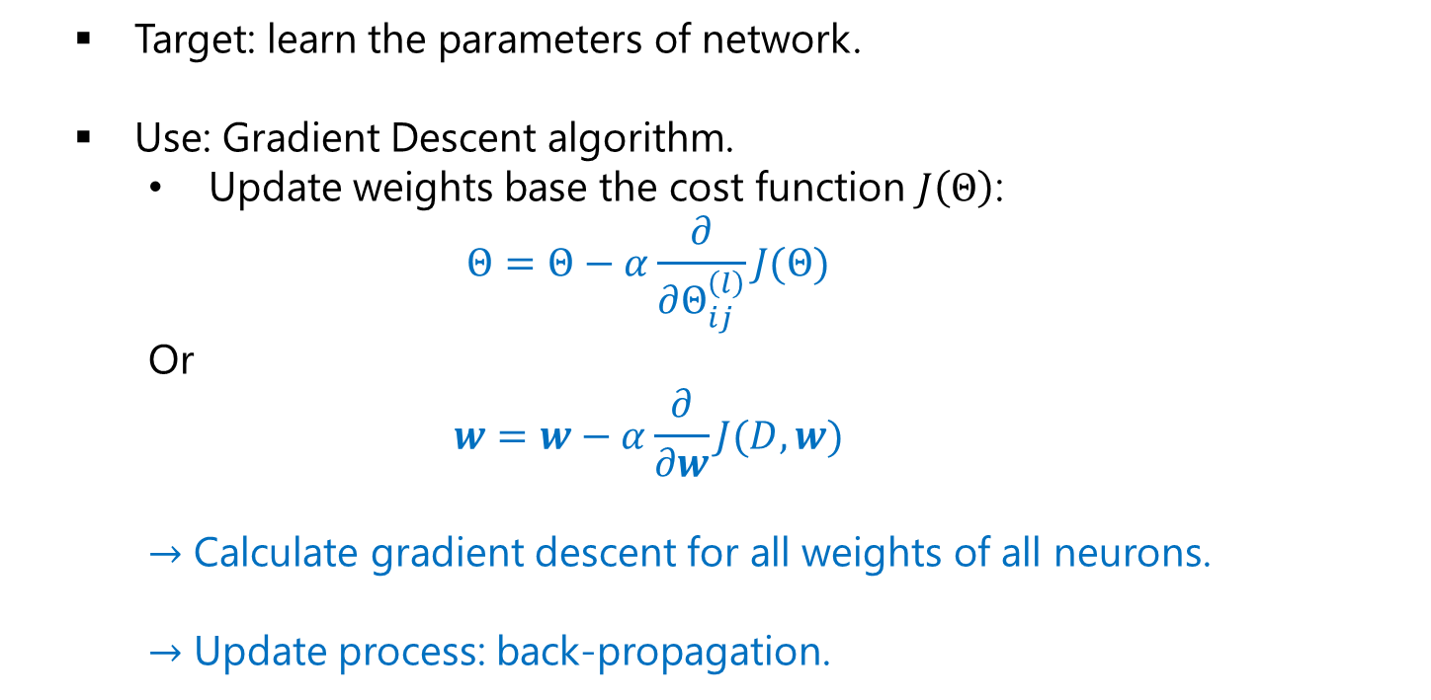
Artificial Neural Network - ANN
Multi-layers Perceptron - MLP
Target: learn the parameters of network.
Use: Gradient Descent algorithm.
Update weights base the cost function $J\left(Θ\right)$:
$$Θ=Θ−α\frac{∂}{∂Θ_{ij}^{\left(l\right)}}J(Θ)$$
Or
$$w=w−α\frac{∂}{∂w}J(D,w)$$
$→$ Calculate gradient descent for all weights of all neurons.
$→$ Update process: back-propagation.
18

Slide 19
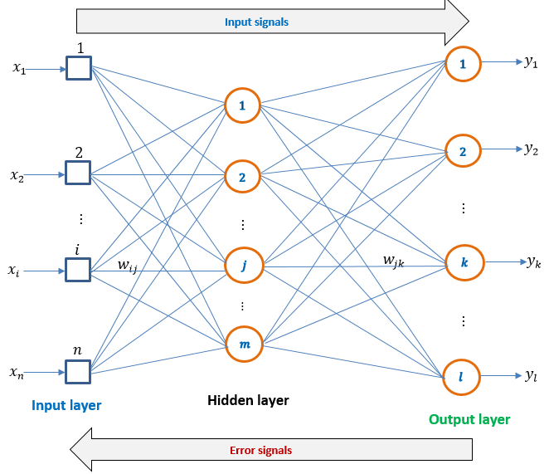
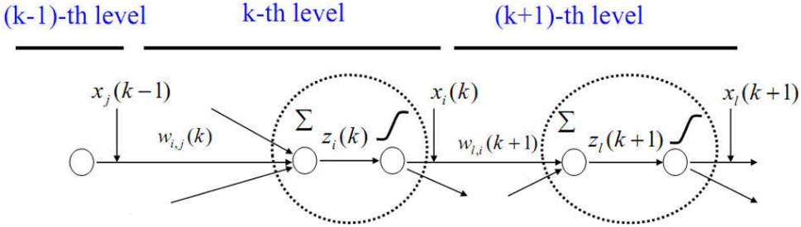

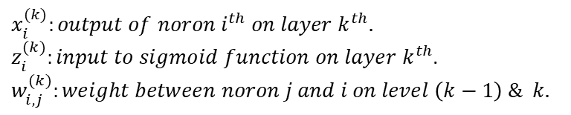

Artificial Neural Network - ANN
MLP – Back Propagation
Feed forward: spread signals from Input layer to Output layer.
At each neuron:
$$x_{i}^{(k)}:output of noron i^{th} on layer k^{th}.$$
$z_{i}^{(k)}:input to sigmoid function on layer k^{th}$.
$$w_{i,j}^{(k)}:weight between noron j and i on level \left(k−1\right) \& k.$$
$$z_{i}^{(k)}=w_{i,0}^{(k)}+\sum_{j}{w_{i,j}^{(k)}×x_{j}(k−1)}$$
$$x_{i}^{(k)}=g\left(z_{i}^{(k)}\right)$$
Back forward: spread error signals from output layer and update weights.
19

Slide 20
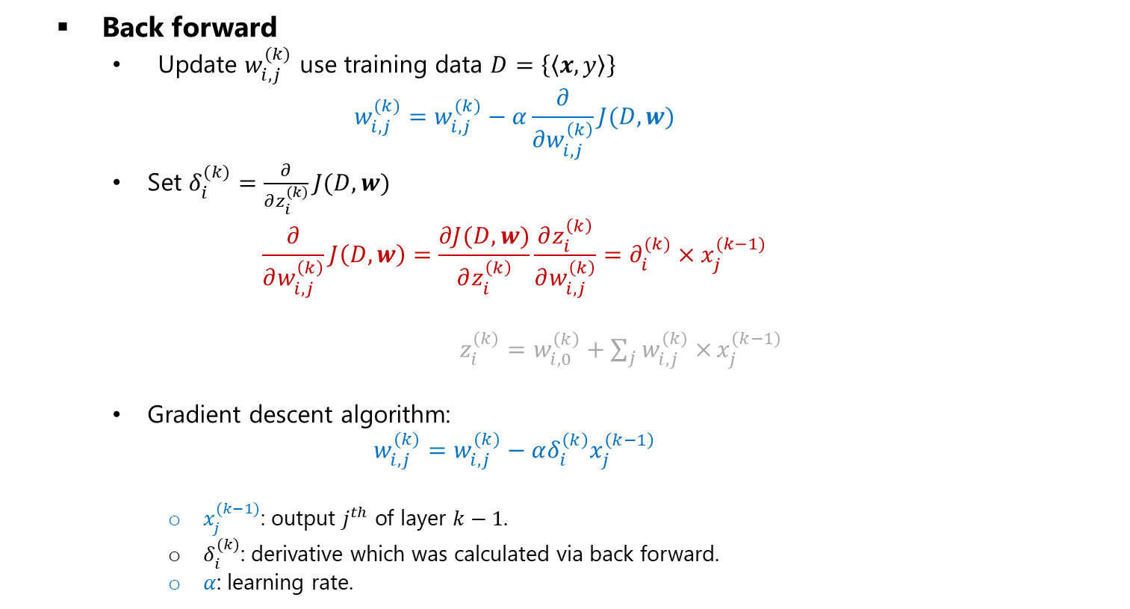
Artificial Neural Network - ANN
MLP – Back Propagation
Back forward
Update $w_{i,j}^{(k)}$ use training data $D=\left\{\left\langle x,y\right\rangle \right\}$
$$w_{i,j}^{(k)}=w_{i,j}^{(k)}−α\frac{∂}{∂w_{i,j}^{\left(k\right)}}J(D,w)$$
Set $δ_{i}^{(k)}=\frac{∂}{∂z_{i}^{\left(k\right)}}J(D,w)$
$$\frac{∂}{∂w_{i,j}^{\left(k\right)}}J\left(D,w\right)=\frac{∂J(D,w)}{∂z_{i}^{\left(k\right)}}\frac{∂z_{i}^{\left(k\right)}}{∂w_{i,j}^{\left(k\right)}}=∂_{i}^{(k)}×x_{j}^{(k−1)}$$
$z_{i}^{(k)}=w_{i,0}^{\left(k\right)}+\sum_{j}{w_{i,j}^{(k)}×}x_{j}^{(k−1)}$
Gradient descent algorithm:
$$w_{i,j}^{(k)}=w_{i,j}^{(k)}−αδ_{i}^{\left(k\right)}x_{j}^{\left(k−1\right)}$$
$x_{j}^{(k−1)}$: output $j^{th}$ of layer $k−1$.
$δ_{i}^{(k)}$: derivative which was calculated via back forward.
$α$: learning rate.
20

Slide 21
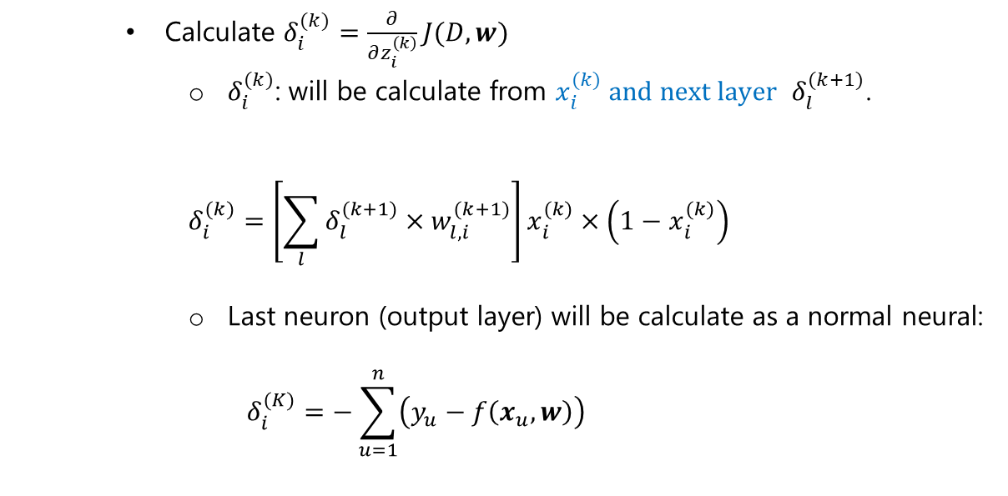
Artificial Neural Network - ANN
MLP – Back Propagation
Calculate $δ_{i}^{(k)}=\frac{∂}{∂z_{i}^{\left(k\right)}}J(D,w)$
$δ_{i}^{(k)}$: will be calculate from $x_{i}^{(k)} and next layer$ $δ_{l}^{(k+1)}$.
$$δ_{i}^{(k)}=\left[\sum_{l}{δ_{l}^{(k+1)}×w_{l,i}^{(k+1)}}\right]x_{i}^{(k)}×\left(1−x_{i}^{(k)}\right)$$
Last neuron (output layer) will be calculate as a normal neural:
$$δ_{i}^{(K)}=−\sum_{u=1}^{n}{\left(y_{u}−f\left(x_{u},w\right)\right)}$$
21

Slide 22
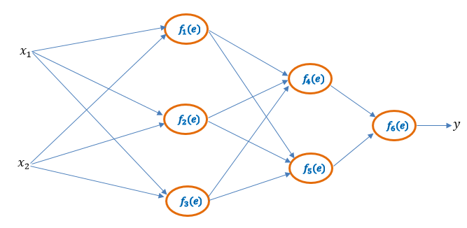
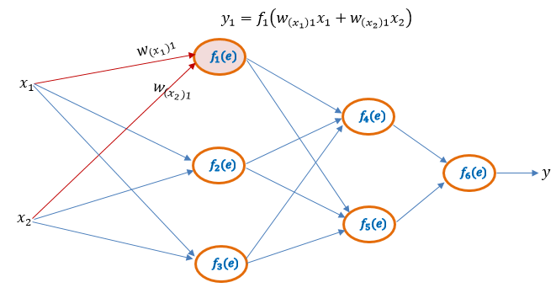
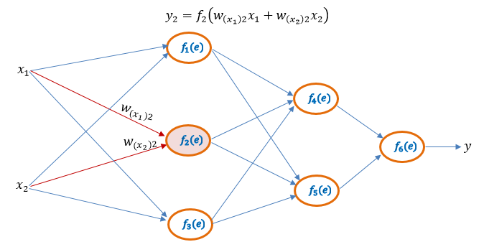

Artificial Neural Network - ANN
Demo Feed Forward
22

Slide 23



Artificial Neural Network - ANN
Demo Feed Forward
23

Slide 24




Artificial Neural Network - ANN
Demo Back Propagation
24

Slide 25




Artificial Neural Network - ANN
Demo Back Propagation
25

Slide 26




Artificial Neural Network - ANN
Demo Back Propagation
26

Slide 27
Contents
“Trending” Terms
TT
Groups of Algorithms
G-As
Artificial Neural Network
ANN
Demo - Mobilenet
MN
27

Slide 28



Demo - Mobilenet
Classification
Dogs
Cats
Horses
Rose
Tulip
Dandelion
Daisy
Sunflower
https://www.kaggle.com/alxmamaev/flowers-recognition
28

Slide 29
Demo - Mobilenet
Tensorflow
Is an open source software library for numerical computation using data flow graphs, developed by researchers and engineers working on the Google Brain Team within Google's Machine Intelligence research organization.
The flexible architecture allows you to deploy computation to one or more CPUs or GPUs in a desktop, server, or mobile device with a single API.
Include tools, libraries and community resources that lets researchers push the state-of-the-art in ML and developers easily build and deploy ML powered applications
29
https://www.tensorflow.org/

Slide 30
Demo - Mobilenet
Transfer Learning with Keras
Keras is a library developed in 2015 by François Chollet (Google). It is an open source for neural networks written by python language.
Keras is a ‘high-level API’ that can be used in conjunction with famous deep learning libraries (‘low-level’ or a backend) such as TensorFlow, CNTK (Microsoft), or Theano (by Prof. Yoshua Bengio). Keras has a much simpler syntax than them.
Advantages: easy to use, fast model building; can run on both cpu and gpu; support to build CNN, RNN and can combine both.
Keras provided deep learning models with pre-trained weights. These models can be used to predict, extract features and tweak. Some model: Xception, VGG16, VGG19, ResNet, ResNetV2, ResNeXt, InceptionV3, InceptionResNetV2, MobileNet, MobileNetV2, DenseNet.
Choose Keras with TensorFlow as ‘backend’ and MobileNet model.
30
https://www.tensorflow.org/

Slide 31

Demo - Mobilenet
Environment Setup
Install Python 3.5 – 3.6 (ex: 3.6.8)
Pip install packet
Tensorflow 1.13.1
Keras 2.2.4
Numpy 0.24.2
Pandas 1.16.3
Pillow 6.0.6
Matplotlib 3.0.2
https://www.tensorflow.org/install/errors
31

Slide 32

Demo - Mobilenet
Train
Import libs/packets.
32

Slide 33


Demo - Mobilenet
Train
base_model = MobileNet(weights = 'imagenet', include_top = False)
ImageNet: 14 million images (hand-annotated), more 20,000 categories.
The ImageNet Large Scale Visual Recognition Challenge (ILSVRC), 2010.
Mobilenet: trained on the imagenet dataset for a thousand classes → will have a last layer consisting of 1000 neurons (one for each class).
Include top = True
Include top = False
Output layer
Input layer
Input layer
Hidden layers
Hidden layers
33

Slide 34









Demo - Mobilenet
Train
x = base_model.output
x = GlobalAveragePooling2D()(x)
X
$$1×1024$$
None is data_format = 'channels_last'
$$Avarage or Max$$
$$3×1$$
$$3×3×1024$$
data_format = 'channels_first'
34

Slide 35

Demo - Mobilenet
Train
x = Dense(1024, activation = 'relu')(x) #we add dense layers
x = Dense(1024, activation = 'relu')(x) #dense layer 2
x = Dense(512, activation = 'relu')(x) #dense layer 3
base_model
X
Hidden layer 1
Hidden layer 2
Hidden layer 3
35

Slide 36

Demo - Mobilenet
Train
preds = Dense(8, activation = 'softmax')(x) #final layer with softmax activation
model = Model(inputs = base_model.input, outputs = preds)
→ Architecture was completed.
Output layer
Input layer
X
Hidden layer 1
Hidden layer 2
Hidden layer 3
base_model
36

Slide 37

Demo - Mobilenet
Train
train_datagen = ImageDataGenerator(preprocessing_function = preprocess_input)
train_generator = train_datagen.flow_from_directory('./train/data/',
# this is where you specify the path to the main data folder target_size = (224, 224), color_mode = 'rgb’, batch_size = 32,
class_mode = 'categorical’, shuffle = True) # class_mode = regression
step_size_train = train_generator.n/train_generator.batch_size
model.fit_generator(generator = train_generator, steps_per_epoch = step_size_train, epochs = 5) #loops on dataset
#images on dataset: 128; #batch_size: 32; #step_size_train: ${128}/{32=4}$
#epochs: 5
epoch_index = 1: divide the dataset into four (step_size_train) blocks, size of a block is 32(batch_size). Tensor = [$32×$[$224×224×3$]]
….
model.save('./model/alpha_MobileNet_None_.h5')
37

Slide 38

Demo - Mobilenet
Predict
labels = ['cats','daisy','dandelion','dogs','horses','rose','sunflower','tulip’]
model = load_model("model\\alpha_MobileNet_None_")
img = image.load_img(f, target_size = (224, 224))
x = image.img_to_array(img)
x = np.expand_dims(x, axis = 0) //→$tensor is [\left[224×224×3\right]]$
x = preprocess_input(x)
ypred = model.predict(x)[0]
y_prex_index = np.argmax(ypred)
predict_name = labels[y_prex_index]
38

Slide 39


Demo - Mobilenet
Train
39

Slide 40

Demo - Mobilenet
Train
40

Slide 41


Demo - Mobilenet
Train
41

Slide 42
Demo - Mobilenet
Result
Train: 12651 images belonging to 8 classes
Test: 479 images.
base_model = MobileNet(weights = ‘None', include_top = False)
total = 479 numTrue = 92 alpha_MobileNet_ have acc = total/numTrue = 0.19206680584551147
base_model = MobileNet(weights = 'imagenet', include_top = False)
total = 479 numTrue = 455 alpha_MobileNet_ have acc = total/numTrue = 0.9498956158663883
42

Slide 43





Demo - Mobilenet
Result - Cats
Dogs
Dogs
Dandelion
Daisy
43

Slide 44




Demo - Mobilenet
Result – Daisy
OK
44

Slide 45








Demo - Mobilenet
Result – Daisy
NG
Dandelion
Dandelion
Dandelion
Dandelion
Sunflower
Sunflower
Cats
Tulip
45

Slide 46

Demo - Mobilenet
Result – Dandelion
OK
46

Slide 47





Demo - Mobilenet
Result – Dandelion
NG
Sunflower
Sunflower
Sunflower
Cats
Daisy
47

Slide 48

Demo - Mobilenet
Result – Dogs
OK
48

Slide 49








Demo - Mobilenet
Result – Dogs
NG
Cats
Cats
Cats
Cats
Cats
Cats
Cats
Horses
49

Slide 50

Demo - Mobilenet
Result – Horses
OK
50

Slide 51

Demo - Mobilenet
Result – Horses
NG
51

Slide 52

Demo - Mobilenet
Result – Rose
OK
52

Slide 53










Demo - Mobilenet
Result – Rose
NG
Tulip
Horses
Tulip
Tulip
Dogs
Tulip
Sunflower
Daisy
Tulip
Tulip
53

Slide 54


Demo - Mobilenet
Result – Sunflower
OK
54

Slide 55







Demo - Mobilenet
Result – Sunflower
NG
Tulip
Cats
Daisy
Dandelion
Tulip
Dandelion
Tulip
55

Slide 56



Demo - Mobilenet
Result – Tulip
OK
56

Slide 57





Demo - Mobilenet
Result – Tulip
NG
Rose
Rose
Daisy
Sunflower
Dogs
57

Slide 58
Reference
[1] Bishop, Christopher, Pattern Recognition and Machine Learning . In Information Science and Statistics series, Springer-Verlag New Yor, 1613-9011, 2006.
https://www.phamduytung.com/blog/2019-04-02-deep-learning-view/#ixzz5nItNdRgH
https://www.phamduytung.com/blog/2019-04-19-deep-learning-view/
https://www.tensorflow.org/
https://keras.io/
https://machinelearningmastery.com/transfer-learning-for-deep-learning/
58

Slide 59

ISB Vietnam Corporation
Section 1 - Section 2
Hang Dang
Thank you for your attention!
Ask & Answer
mailto: dthang@vn.isb.co.jp

Slide 60

Artificial Neural Network - ANN
Activation function
Step and Sign is hard limiter functions.
60

Slide 61



Artificial Neural Network - ANN
Perceptron
61

Slide 62

Artificial Neural Network - ANN
Perceptron
62

Slide 63



Artificial Neural Network - ANN
Perceptron
Input layer
Hidden layer 1
Output layer
63

